Slide 1

Sprocket Central Pty Ltd
Data analytics approach
[Division Name] - [Engagement Manager], [Senior Consultant], [Junior Consultant]

Slide 2
Agenda
Introduction
Data Exploration
Model Development
Interpretation

Slide 3
Introduction
Main objective of Analysis:
Recommend which of the 1000 new customers should be targeted to drive the most value for Sprocket Central Pty Ltd.
Preliminary Data Exploration
Data Quality
Targeting high value customers based on customer demographics and attributes
Top
Customers
New Customers
1.Customer Demographic
2.Customer Addresses
2.Transactions data in the past 3 months
Accuracy
Completeness
Consistency
Currency
Relevancy
Validity
Uniqueness
RFM Analysis

Slide 4
Data Exploration
Place headline insight or information here. This should be the most important point for this slide.
Place any information about this point here.
Place any supporting images, graphs, data or extra text here.

Slide 5
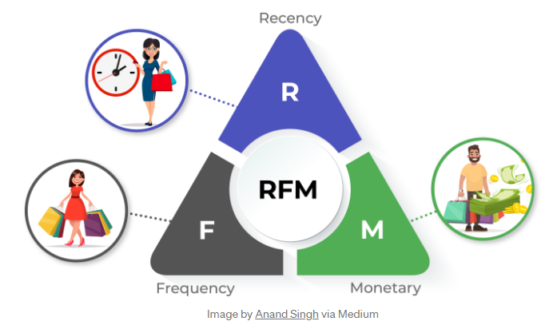
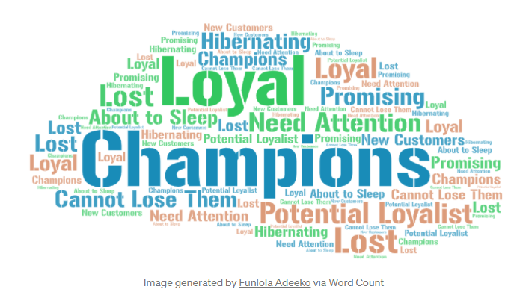
Model Development
RFM Analysis/Technique

Slide 6
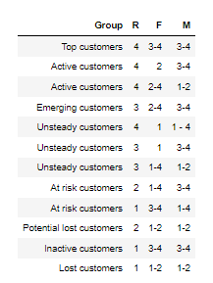
Model Development
RFM Analysis/Technique
Group | Description
Top customers | Current, frequent, large revenues
Active customer | Continuous revenue
Emerging customers | Potential for cross-and upselling
Unsteady customers | Potential for cross-and upselling depending of the offer
At risk customers | Non-current, but partly frequent and high revenues
Potential lost customers
Inactive customers | Non-current, rare but high revenues
Lost customers

Slide 7
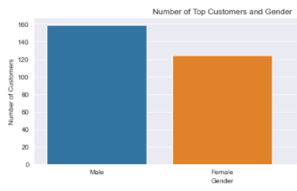
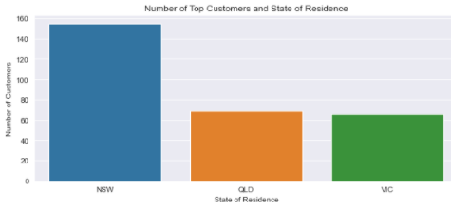
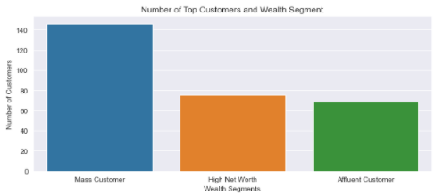
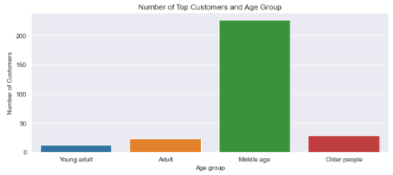
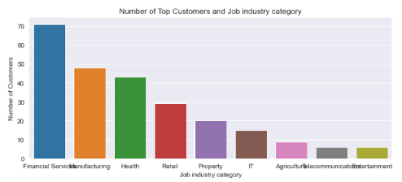
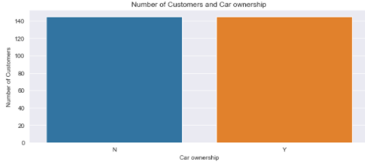
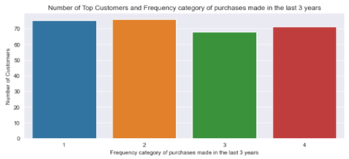
Interpretation

Slide 8
Interpretation
Place headline insight or information here. This should be the most important point for this slide.
Place any information about this point here.
Place any supporting images, graphs, data or extra text here.

Slide 9
Interpretation
Place headline insight or information here. This should be the most important point for this slide.
Place any information about this point here.
Place any supporting images, graphs, data or extra text here.

